Slide 1

PREDICT ABSENTEEISM AT WORK
Result
Problem
Applied Modeling & Quantitative Methods- Final Semester
Thank You
About
Contribution
Methodology
Name – Sahil Nagpal & Pramina Patil Student Number – 0670042 & 0663967.

Slide 2


About Us
Project Top Off
Predicting the probability of the absenteeism at workplace (with or without reason).
Team Members
Background of Project
We all had the opportunity to work at several national and international organizations where we had different experiences in terms of efficiency, working climate, and place. All of those experiences filled us with a quest to learn the basic facts of workplace absenteeism.
What we are seeking for ?
Anticipate the probability of an employee of being absent at the workplace with or without any impacting impetus.
Thank You
Result
Problem
Contribution
Methodology
About

Slide 3

Problem Introduction
What is Absenteeism ?
Absenteeism in the workplace occurs when an employee chronically stays absent from work without cause.
How this Project help ?
Reckon the precise probability of the absenteeism in an organization based on the possible extant in the data.
How Data Science leverage ?
Previous studies only predicted the cause for absence, this modelling would help predict the likelihood of actual absence and exploit other models of classification (other than Artificial Intelligence).
How Subject Matter Experts take edge advantage ?
Absenteeism is an indirect menace to profit. SME’s will have insights of pattern from this model.
Result
Problem
Thank You
About
Contribution
Methodology

Slide 4


Impact of the Absenteeism
2010
2014
2018
14.67
26.78
43.4
Result
Loss Percentage
Loss Percentage
Loss Percentage
Problem
Thank You
Methodology
About
Contribution
Negative effect on Productivity
Negative effect on Finances
Negative effect on Team Morale

Slide 5
Initial Thought (Hypothesis)
We Can irrefutably say that both workers and employers may be adversely impacted by absenteeism. The employer runs the risk of efficiency and labor costs being lost, eventually impacting the bottom line of the corporation.
In addition, chronic absenteeism leads to employee turnover, contributing to higher labor and recruiting costs when it is necessary to bring replacement workers on board.
Result
Problem
Thank You
Methodology
About
Contribution

Slide 6
Data Erudition
Data Collected - https://archive.ics.uci.edu/ml/datasets/Absenteeism+at+work
Column Name | Data Type
ID | Integer
﻿Reason for Absence | Integer
﻿Date | Date
﻿Transportation Expense | Integer
﻿Distance to Work | Float
﻿Age | Integer
﻿Daily Work Load Average | Float
﻿Body Mass Index | Float
﻿Education | Integer
﻿Children | Integer
﻿Pets | Integer
﻿Absenteeism Time in Hours | Float
Result
Problem
Thank You
Methodology
About
Contribution

Slide 7
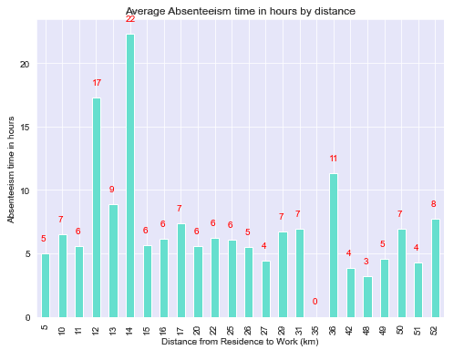
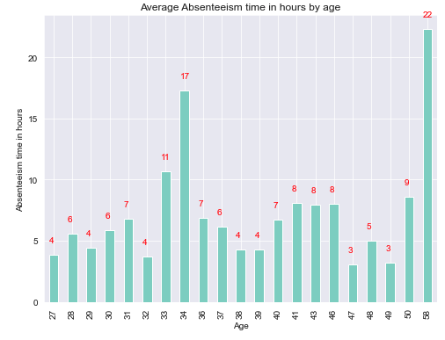
Data Methodology and Pre-Processing
Exploratory Analysis
Absent Time and Distance from Residence
Result
Problem
Thank You
Methodology
About
Contribution
Exploratory Analysis
2. Absent Time and Age

Slide 8
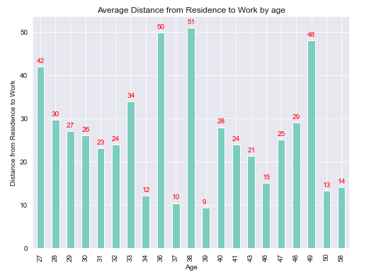
Data Methodology and Pre-Processing
Exploratory Analysis
3. Average Distance from Residence by Age
Result
Problem
Thank You
Methodology
About
Contribution

Slide 9
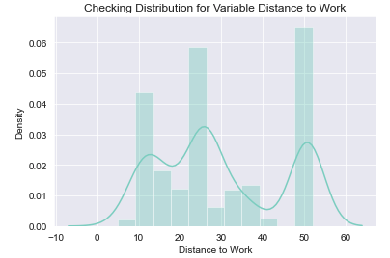
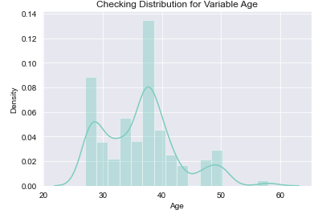
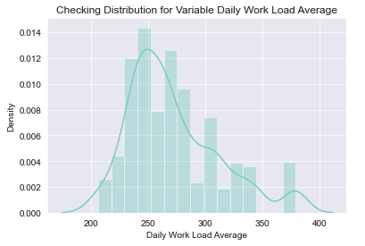
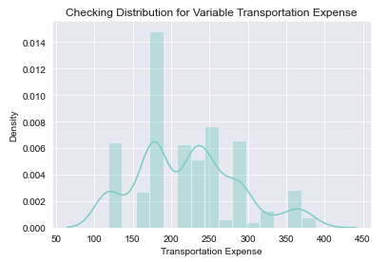
Data Methodology and Pre-Processing
Normal Distribution - Normal distribution check of each column to check the skewness in the data.
Result
Problem
Thank You
Methodology
About
Contribution

Slide 10
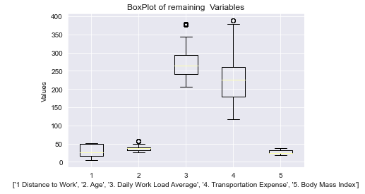
Data Methodology and Pre-Processing
Outlier Detection - Outliers are nothing but a problem which deviates the accuracy of the model from its precision, in order to handle we first find out the outlier values and replace them with their closest median values.
Result
Problem
Thank You
Methodology
About
Contribution

Slide 11
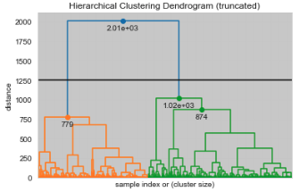
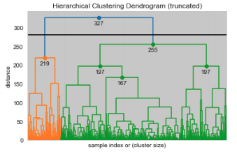
Data Methodology and Pre-Processing
Clustering the data - The algorithm begins with all data points allocated to their own cluster.
Result
Problem
Thank You
Methodology
About
Contribution

Slide 12
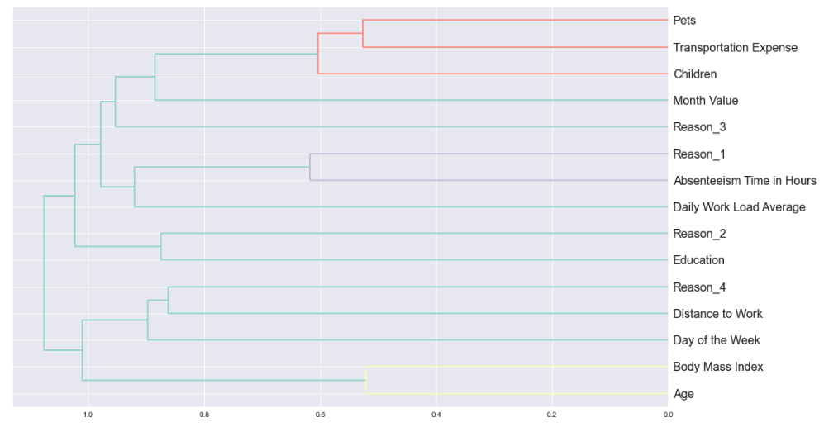
Data Methodology and Pre-Processing
Feature Scaling - There is a probability that several variables are not at all important to the problem of class prediction in our research. The selection of subsets of corresponding columns for model construction is known as the Feature Selection.
Result
Problem
Thank You
Methodology
About
Contribution

Slide 13
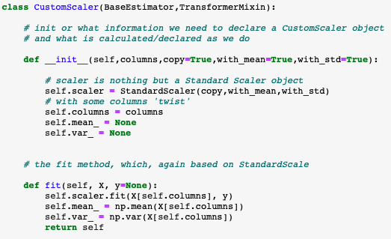
Data Methodology and Pre-Processing
Standardize the data- Standardization is one of the most popular pre-processing tools as data of different magnitude (scale) may be skewed to high values, we want all inputs to be of similar magnitude.
Result
Problem
Thank You
Methodology
About
Contribution

Slide 14
Result
Problem
Thank You
Methodology
About
Contribution
2011
2014
2017
Artificial Neural
Network
Results Turnovers
Other Classifications Dive
Researchers came with ICD certified reasons and non certified reasons.
In 2011, Researchers start predicting the reason for absenteeism.
Others techniques start predicting other aspects of problems.

Slide 15
Previous Helping Hands – Related Work
Previous Studies and Researches - The researches from decades using the shallow Neural Network to find the actual trend/pattern of absenteeism. In 2019, latest researchers from USA implemented various classification to overcome the drawbacks of ANN to produce the fitted yield.
Source - https://www.hindawi.com/journals/complexity/2020/5843932/
Result
Problem
Thank You
Methodology
About
Contribution

Slide 16
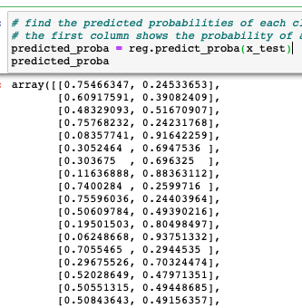
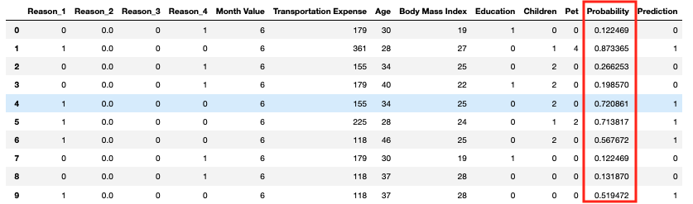
Results and Outcomes
Primary Goal – The original context to build this model was to predict the probability of an employee being absent at the workplace.
The probability of being absent is what is unique among all other research and operations on this particular data. For calculation of the probability, the logistic regression is best model since it comes with the utility (defined function) which helps us to calculate the precise accuracy.
Problem
Thank You
Result
About
Contribution
Methodologies

Slide 17
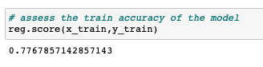
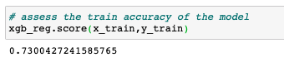
Results and Outcomes
Secondary Goal – The secondary goal was to implement classification techniques other than those are previously used.
For the classification purpose I have used Logistic Regression and Gradient Boost.
Result
Problem
Thank You
About
Contribution
Methodologies
Classification Technique | Accuracy Score
Logistic Regression | 78 %
Gradient Boosting | 73 %

Slide 18



Results and Outcomes
Why the Journey was Useful – Learning about absenteeism helps to know more about the business prospective of an organization. We learned how absenteeism impacted businesses not only in monetary terms but also in terms of productivity.
Result
Problem
Thank You
Contribution
Methodology
About

Slide 19
Results and Outcomes
How ML benefits us: The only issue here was predicting the probability of the absenteeism was the absence of more informative data that diminish the interest in the researchers. But Machine Learning made our work easier.
Result
Problem
Thank You
Contribution
Methodology
About

Slide 20
Results and Outcomes
Future Aspects – The future of this research has a very wide domain since the technology always helps to gain more and impactful insights related to absenteeism and their related fields. The companies are spending millions to predict absenteeism which will eventually get them profit.
Result
Problem
Thank You
Contribution
Methodology
About

